Slide 1
Chatbot PoC on AWS

Slide 2
Intro – What are Chatbots ?
Chatbot (Talkbot) Amazon Lex is a service for building conversational interfaces using voice and text. Powered by the same conversational engine as Alexa, Amazon Lex provides high quality speech recognition and language understanding capabilities, enabling addition of sophisticated, natural language ‘chatbots’ to new and existing applications. Amazon Lex reduces multi-platform development effort, allowing you to easily publish your speech or text Chabot to mobile devices and multiple chat services, like Facebook Messenger, Slack, Kik, or Twilio SMS. Native interoperability with AWS Lambda, AWS MobileHub and Amazon CloudWatch and easy integration with many other services on the AWS platform including Amazon Cognito, and Amazon DynamoDB makes bot development effortless
The main benefit of chatbot is that it save time and efforts by automating customer support.

Slide 3
What tools we used
Chatbot platform tools used are:
TARS:-TARS enables individuals and businesses to create chatbot that can be used on your website and Facebook Messenger with no programming knowledge at all.
Chatfuel:-Chatfuel is a free bot-building platform that lets you create chatbot on FB messenger and Telegram with no prior coding experience required. Chatfuel is currently being used by NFL and NBA teams, and publishers like TechCrunch and Forbes.
ManyChat:-ManyChat lets you create a Facebook Messenger bot for marketing, sales and support. With ManyChat’s visual drag and drop builder.

Slide 4
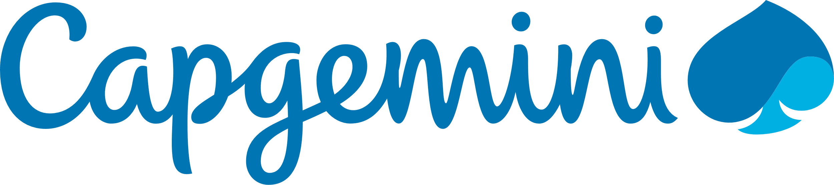

Who will benefit from them ?
How Capgemini will benefit
Capgemini will have an automated system which would act as a frontier in knowing customer demands and thus helps in saving man power and time .
How customer will benefit
Customer will be immediately able to deliver and present his queries ,thoughts ,business requirements hence providing his accurate details and on the same time would be getting instant responses which would save customer’s time too.

Slide 5
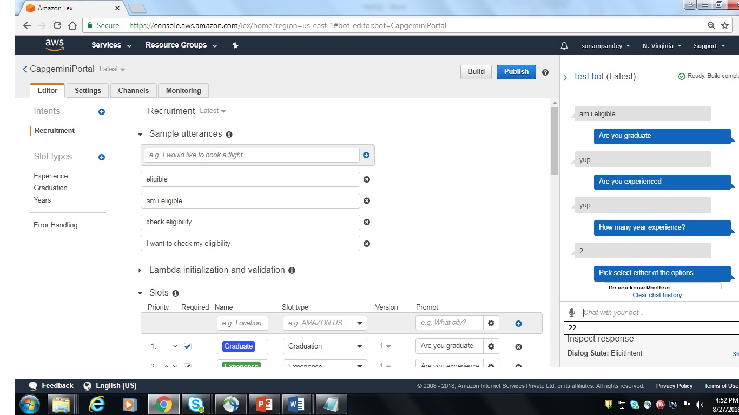
Solution Approach AWS Lex Diagram
Leverage AWS tool chain to deliver infrastructure as code through the pipeline.

Slide 6
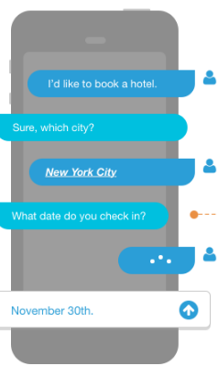
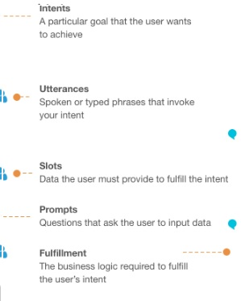
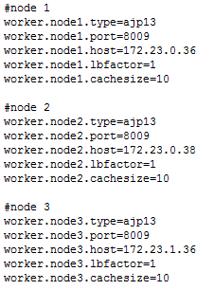
Qn&A in Lex
Some screenshots like this
Tomcat1
<Engine name="Catalina" defaultHost="localhost" jvmRoute=“node1">
Tomcat2
<Engine name="Catalina" defaultHost="localhost" jvmRoute=“node2">
Tomcat3
<Engine name="Catalina" defaultHost="localhost" jvmRoute=“node3">
Apache workers.properties

Slide 7
Why Amazon lex?
Easy to use
Amazon Lex provides an easy-to-use console to guide you through the process of creating your own chatbot in minutes, building conversational interfaces into your applications. You supply just a few example phrases and Amazon Lex builds a complete natural language model through which your user can interact using voice and text, to ask questions, get answers, and complete sophisticated tasks.
Seamlessly Deploy and Scale
With Amazon Lex, you can build, test, and deploy your chatbots directly from the Amazon Lex console. Amazon Lex enables you to easily publish your voice or text chatbots to mobile devices, web apps, and chat services such as Facebook Messenger, Slack, Kik, and Twilio SMS. Once published, your Amazon Lex bot processes voice or text input in conversation with your end-users. Amazon Lex is a fully managed service so as your user engagement increases, you don’t need to worry about provisioning hardware and managing infrastructure to power your bot experience.

Slide 8
Built-in Integration with the AWS Platform
Amazon Lex provides built-in integration with AWS Lambda, AWS MobileHub and Amazon CloudWatch and you can easily integrate with many other services on the AWS platform including Amazon Cognito, and Amazon DynamoDB. You can take advantage of the power of the AWS platform for security, monitoring, user authentication, business logic, storage and mobile app development.
Cost Effective
With Amazon Lex, there are no upfront costs or minimum fees. You are only charged for the text or speech requests that are made. Amazon Lex’ pay-as-you-go pricing and low cost per request make it a cost-effective way to build conversational interfaces anywhere. With the Amazon Lex free tier, you can easily try Amazon Lex without any initial investment

Slide 9
LATEST version of chatbot
The $LATEST version of your bot should only be used for manual testing. Amazon Lex limits the number of runtime requests
that you can make to the $LATEST version of the bot. When you update an alias Lex takes few minutes to pick up change.
Session Timeout:-
The session timeout set when the bot was created determines how long the bot retains conversation context, such as current
user intent and slot data.
After a user starts the conversation with your bot and until the session expires, Amazon Lex uses the same bot version, even
if you update the bot alias to point to another version.

Slide 10




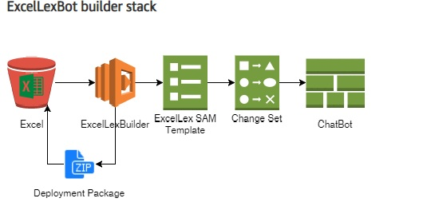
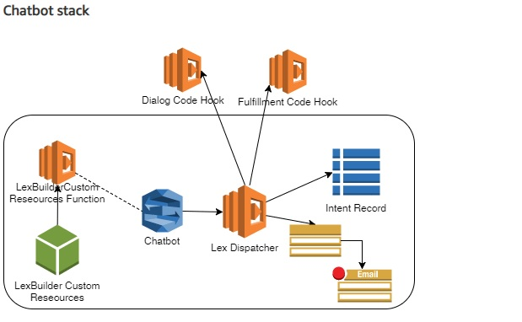
Lex plus Lambda using Excel
Browser
www.celebritycruises.com
Amazon Elastic Load Balancer
Zone A
Zone B
Apache 1
Apache 2
Apache 3
Apache 4
Mod_proxy
Mod_proxy
Mod_proxy
Mod_proxy
Amazon Elastic Load Balancer
Tomcat Tier
Tomcat Tier
Tomcat 1
Tomcat 2
Tomcat 3
Tomcat 4

Slide 11
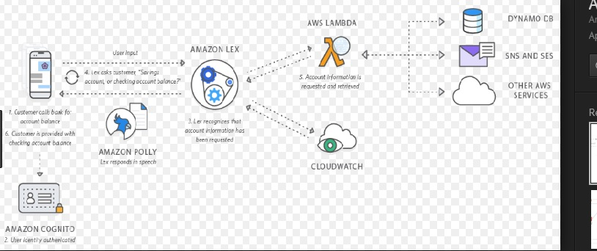
Lex with Database query
Mod_proxy still sends requests to a single ELB
Single ELB configured with diff listeners for each port
ELB handles sticky sessions across Tomcats
Browser
www.celebritycruises.com
Amazon Elastic Load Balancer
Zone A
Zone B
Apache 1
Apache 2
Apache 3
Apache 4
Mod_proxy
8080
Mod_proxy8085
Mod_proxy 8080
Mod_proxy8085
ELB Listener 8080
ELB Listener 8085
Tomcat Tier
Tomcat Tier
Tomcat 1:8080
Tomcat 2:8080
Tomcat 3:8080
Tomcat 4:8080
Tomcat 1:8085
Tomcat 2:8085
Tomcat 3:8085
Tomcat 4:8085

Slide 12
Pros and Cons
Pros:
Brings Automation in communication between client and organization
Instant communication thus saving time
24*7 available client support
Helps in monitoring client data and gaining insights
Easier approach to global market
Cons:
Being a bot might end up in asking same questions again and again(inability to understand)
Similar utterances might end up in producing different output
Zero decision making

Slide 13
Other Cloud Provider for Bots
1 Microsoft azure
2 Google cloud

